Slide 1
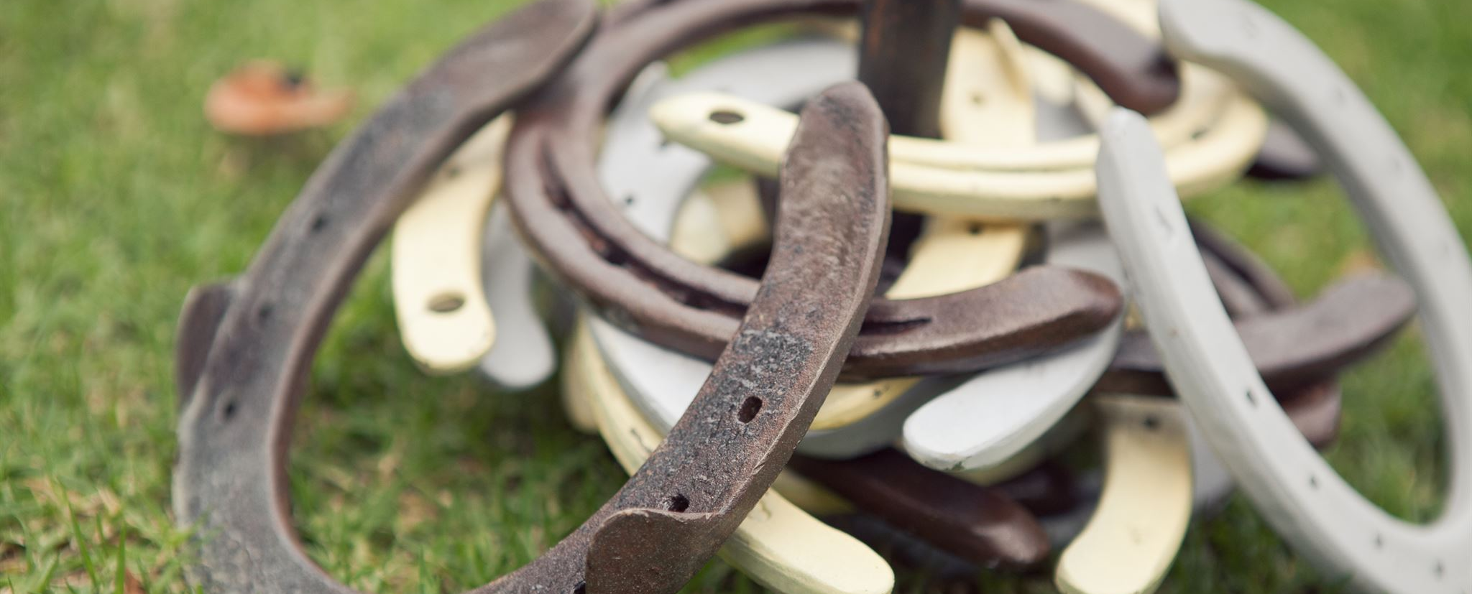
Working Equitation Gear & Welfare Steward Guide
Guidelines for safe equipment and animal welfare practices
Notes:
---

Slide 2
Introduction
Notes:
Role Overview

Slide 3
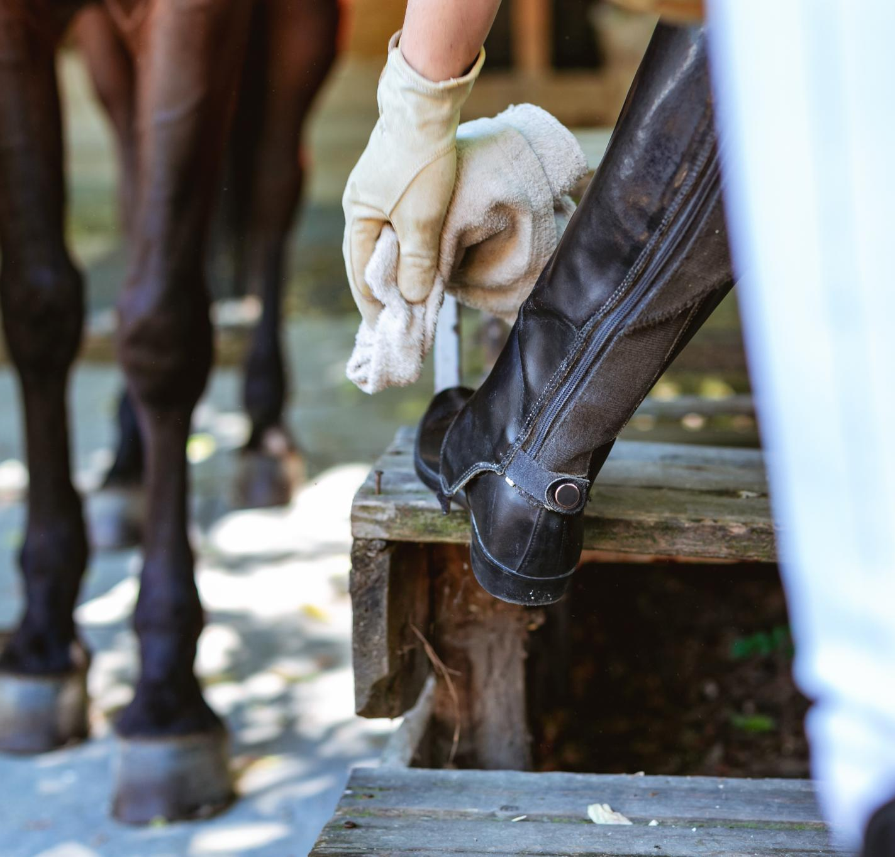
Role Overview
Safety and Welfare Assurance
  The steward ensures safety and welfare of horse and rider during all competition phases.
Rule Compliance Monitoring
  Steward uses the WENZ Rulebook and taper gauge to enforce competition rules accurately.
Liaison Between Competitors and Officials
  The steward facilitates communication ensuring gear and welfare standards are maintained.
Notes:
The Gear & Welfare Steward plays a crucial role in ensuring the safety, welfare, and rule compliance of both horse and rider throughout all phases of a Working Equitation competition. This steward must have access to the current WENZ Rulebook (Version 1.2, July 2025) and a noseband taper gauge at all times. Their responsibilities include inspecting tack and attire, monitoring warm-up areas, and observing horses for signs of distress or injury. The steward acts as a liaison between competitors and officials, ensuring that all gear and welfare standards are upheld to maintain the integrity and safety of the competition.

Slide 4
Steward Responsibilities
Notes:
Primary Duties, Welfare Monitoring

Slide 5
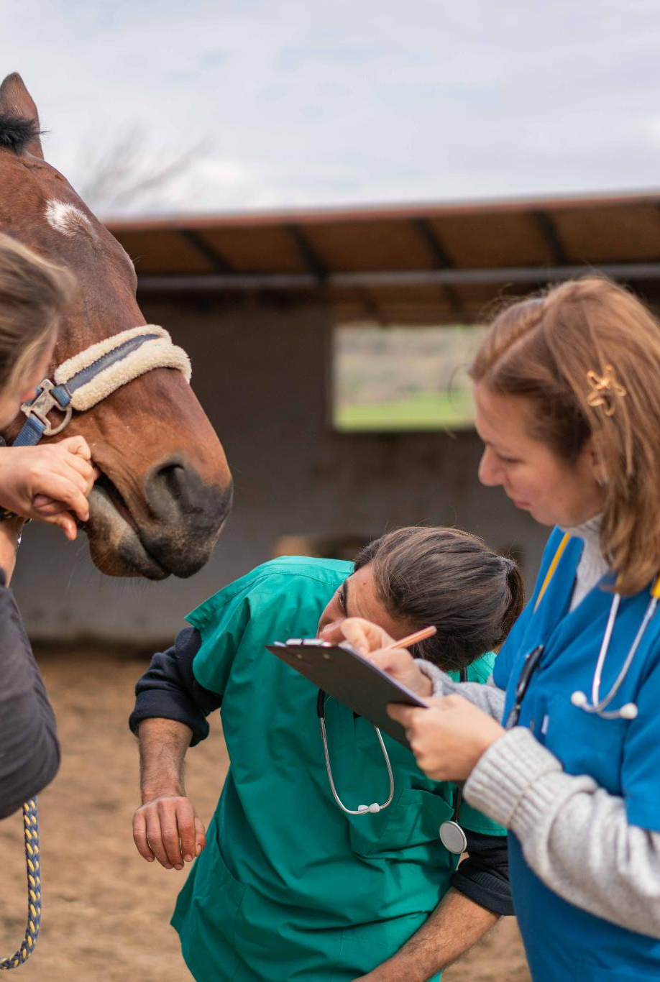
Primary Duties
Gear Inspection
  Inspect tack and attire before, during, and after competition phases to ensure compliance and safety.
Competitor Safety Monitoring
  Monitor competitor numbers in warm-up areas to maintain a safe and controlled environment.
Welfare Observation
  Observe horses for blood, wounds, lameness, or other welfare issues and report concerns promptly.
Rule Enforcement Communication
  Report irregularities to Head Judge and communicate decisions only after official rulings to ensure fairness.
Notes:
The Gear & Welfare Steward is responsible for inspecting tack and attire before the first phase, between phases if gear changes occur, and after completion of all phases. They must use the noseband taper gauge to ensure correct fit and monitor the number of competitors in warm-up areas to maintain safety. Additionally, the steward must observe horses for signs of blood, wounds, lameness, or other welfare issues. Any irregularities must be reported to the Head Judge or Show Manager, and decisions are only communicated to competitors after an official ruling has been made. This ensures fair and consistent enforcement of competition rules.

Slide 6
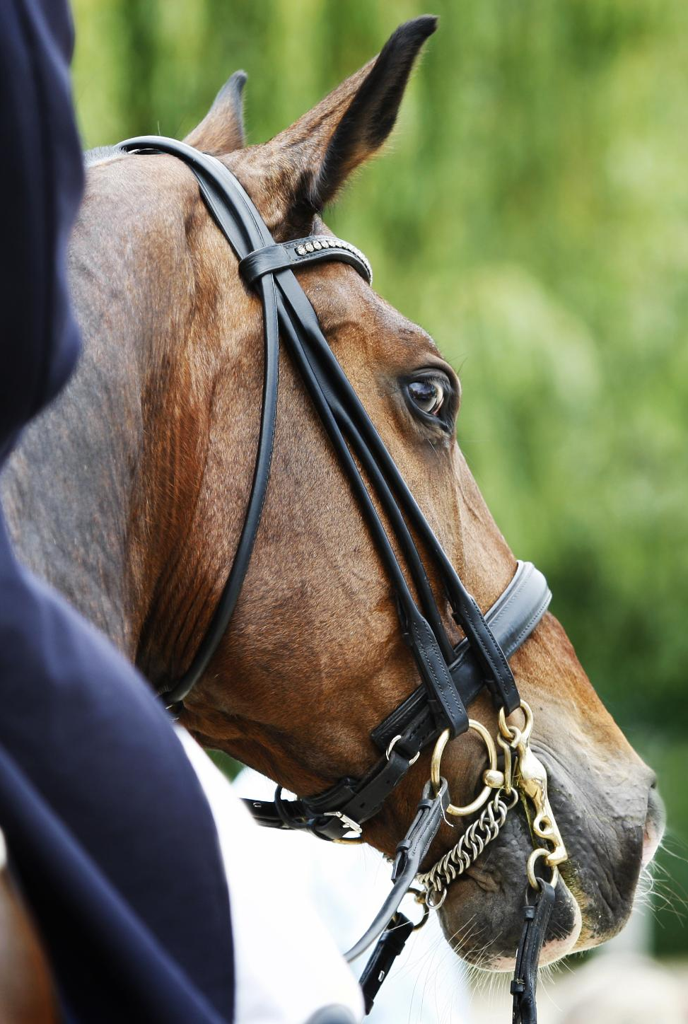
Welfare Monitoring
Steward Responsibility
  Stewards ensure horses are well cared for and free from obvious injury during competitions.
Identifying Welfare Concerns
  Welfare concerns include poor conditioning, inappropriate tack, rider/horse weight imbalance, or excessive performance demands.
Reporting and Prevention
  Stewards report issues promptly to promote ethical treatment and prevent harm to horses in competition.
Maintaining Ethical Standards
  Observations by stewards help maintain high welfare standards and ensure humane equitation principles.
Notes:
Stewards have a responsibility to ensure horses are well cared for and free from obvious injury. Welfare concerns may arise from poor conditioning, inappropriate tack, rider/horse weight imbalance, or horses performing beyond their training level. The steward must be vigilant in identifying these issues and report them to the Head Judge or Show Manager. This proactive approach helps prevent harm and promotes ethical treatment of horses in competition. The steward's observations are critical in maintaining high welfare standards and ensuring that all participants adhere to the principles of humane equitation.

Slide 7
Tack and Attire Inspection
Notes:
General Principles, Tack Regulations, Rider Aids and Accessories, Prohibited Equipment, Attire Guidelines, Helmet Requirements

Slide 8
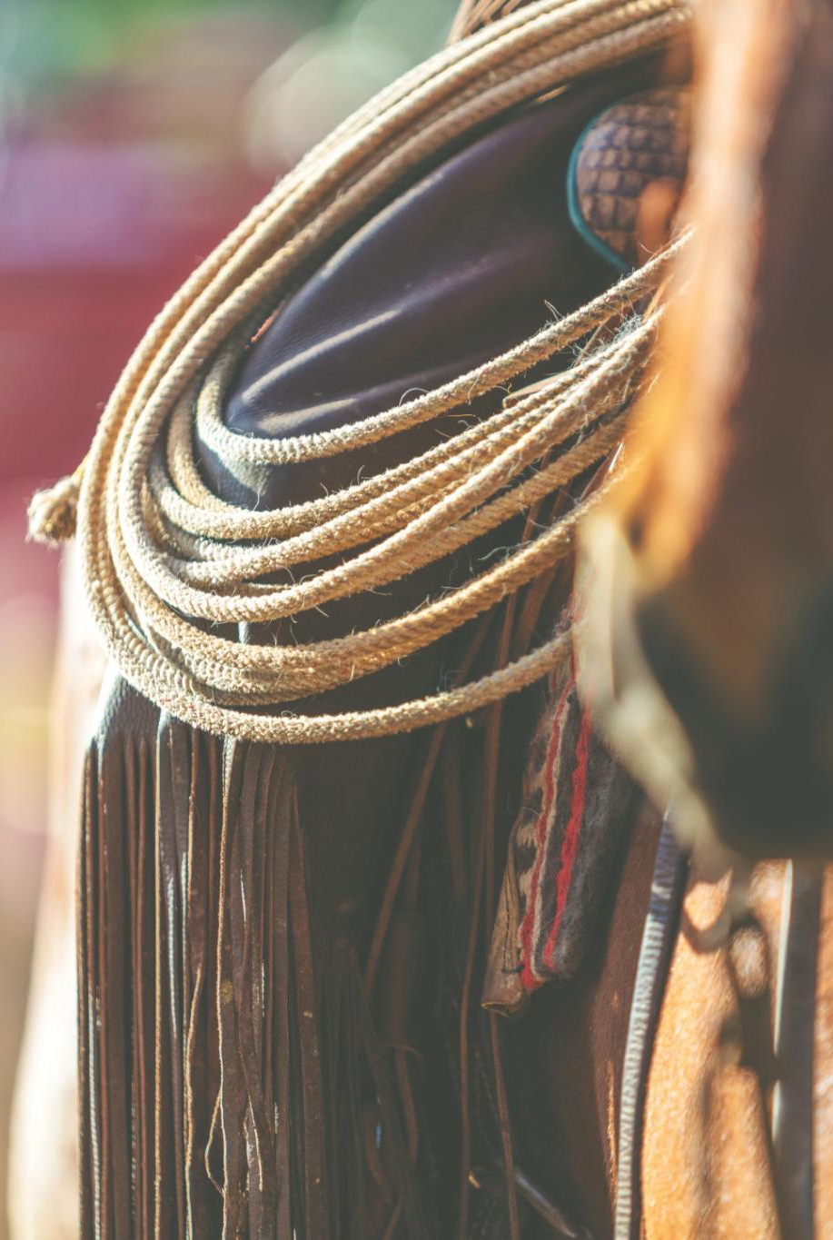
General Principles
Mandatory Tack Requirements
  Competitors must use a saddle with stirrups and a bridle with reins securely attached to ensure safety.
Tack and Attire Consistency
  Consistency in tack and attire across all phases is preferred, allowing phase-specific changes that maintain style.
Identification of Stallions
  Stallions must be identified with red stallion tags on both sides of the bridle for clear recognition.
Role of Stewards
  Stewards must know these guidelines to inspect effectively, ensuring fairness and safety in competitions.
Notes:
All competitors must use a saddle with stirrups and a bridle with reins securely attached. Consistency in tack and attire across all phases is preferred, although changes are permitted if they comply with phase-specific rules and maintain the same stylistic tradition. Stallions must be clearly identified with red stallion tags on both sides of the bridle. These principles ensure uniformity and safety, allowing stewards to efficiently assess compliance and maintain the competition's integrity. The steward must be familiar with these guidelines to perform accurate inspections and support fair competition.

Slide 9
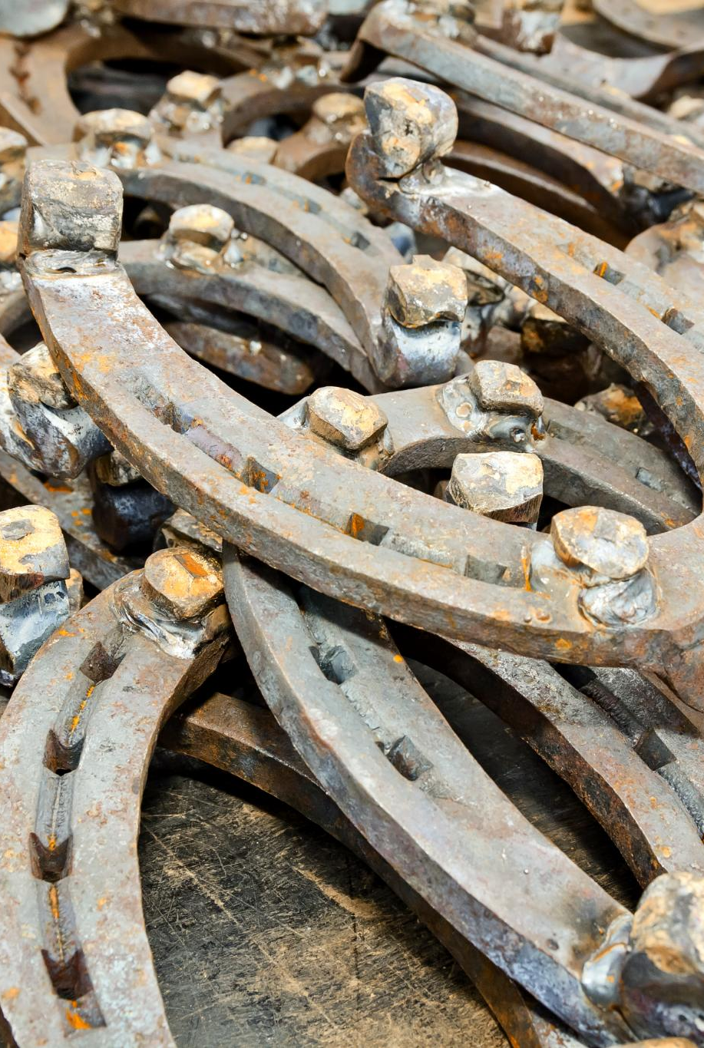
Tack Regulations
Permitted Bits and Accessories
  Allowed bits include rubber, nylon, synthetic, mixed metal, snaffles, Pelhams, Kimblewicks, and double bridles from Novice level. Bit guards and snaffle chin straps are permitted when meeting width requirements.
Prohibited Bits
  Mechanical hackamores, gag bits, twisted or wire bits, elevator bits, and other inhumane bits are not allowed to ensure horse welfare.
Bridles and Nosebands
  Bitless bridles without self-tightening mechanisms are allowed. Nosebands are optional but must allow two vertical fingers or pass the WENZ gauge test.
Saddle Types and Attire
  Saddles must suit the rider's attire and style, including Dressage, General Purpose, Jumping, Stock, Western, and Side-Saddle types.
Notes:
Permitted bits include rubber, nylon, synthetic, and mixed metal types, as well as snaffles, Pelhams, Kimblewicks, and double bridles from Novice level. Bit guards and snaffle chin straps (minimum 2 cm wide) are allowed, along with curb chains that lie flat. Prohibited bits include mechanical hackamores, gag bits, twisted or wire bits, elevator bits, and any bit deemed inhumane. Bitless bridles are allowed if they lack self-tightening mechanisms or shanks. Nosebands are optional but must allow two vertical fingers or pass the WENZ gauge test. Saddles must align with the rider’s attire and style, and acceptable types include Dressage, General Purpose, Jumping, Stock, Western, and Side-Saddle.

Slide 10
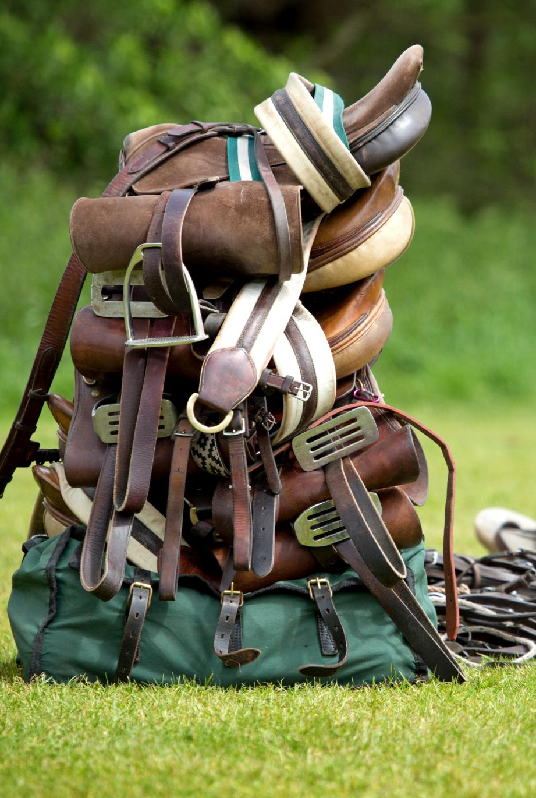
Rider Aids and Accessories
Spurs and Age Restrictions
  Spurs must have rounded edges and are prohibited for riders under 12 years old to ensure safety.
Whip Usage Rules
  Whips allowed up to 1.2 meters for horses and 1 meter for ponies, used only in rein hand during obstacles.
Protective Boots and Bandages
  Boots and leg protection allowed only in obstacle phases; bandages prohibited in all phases and warm-up.
Additional Allowed Equipment
  Neck straps, monkey grips, breastplates, cruppers, nose nets, and fly hoods allowed if discreet and not covering eyes.
Notes:
Spurs must be blunt with rounded edges and are prohibited for riders under 12 years old. Whips are allowed from Introductory to Medium level, with a maximum length of 1.2 meters for horses and 1 meter for ponies. Whips must be held in the rein hand during obstacles, with penalties applied for violations. Boots and leg protection are restricted to obstacle phases, and bandages are prohibited in all phases and warm-up. Other allowed equipment includes neck straps, monkey grips, breastplates, cruppers, nose nets, and fly hoods, which must be discreet and not cover the eyes. Fly hoods must be removed post-phase for inspection, and earplugs are checked by the steward.

Slide 11
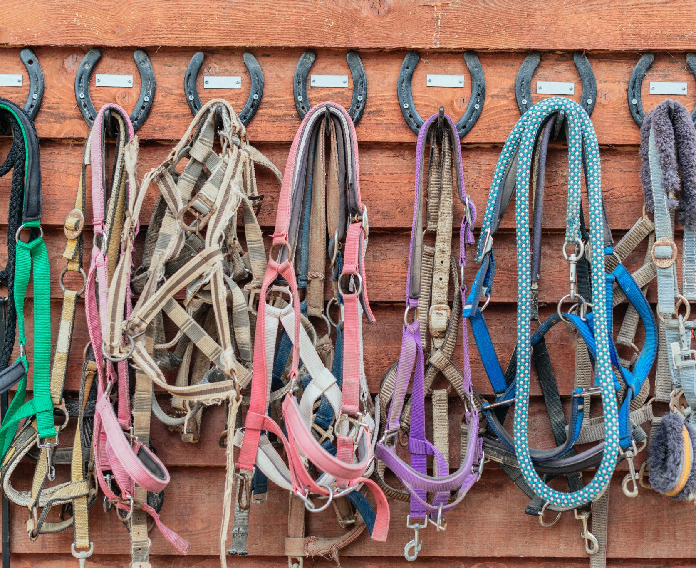
Prohibited Equipment
Reason for Prohibition
  These items are unsafe or inhumane, risking horse welfare and competition integrity.
Role of Stewards
  Stewards must remain vigilant to identify and report prohibited equipment use during competitions. If in doubt discuss this with the Judge at an appropriate time.
List of Prohibited Equipment
  Many items like halters, tie downs, tongueties, and studded nosebands are banned forsafety and fairness.
Notes:
Use of prohibited equipment results in elimination. This includes halters, rope halters with lead ropes, tie downs, tongue ties, martingales, studded or metal nosebands, metal core nosebands, spiked curb chains, bearing, side, draw, or balancing reins, blinkers, earmuffs, ear plugs, leg bandages, and electronic communication devices in the competition arena. These items are considered unsafe or inhumane and are strictly forbidden to ensure the welfare of the horse and the fairness of the competition. Stewards must be vigilant in identifying and reporting any use of such equipment.

Slide 12
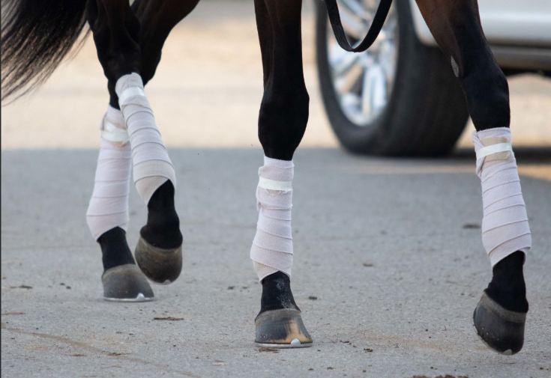
Prohibited Equipment
● Halters, headstalls, rope halters with lead rope
● Tie downs
● Tongue ties
● Martingales of any kind
● Studded, chain, or metal cavessons/nosebands
● Metal core nosebands/serretas
● Studded, spiked curb chain or chinstraps
● Bearing, side, draw, or balancing reins
● Blinkers
● Earmuffs or ear plugs
● Leg bandages and wraps
● Electronic communication devices including Headphones and Earphones may be used in the warm up arena but are prohibited in the competition arena.

Slide 13
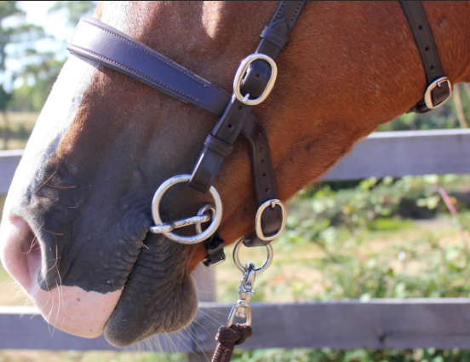
Prohibited Bits
● Mechanical hackamores
● Gag bits
● Twisted or wire bits
● Elevator bits ● Combination bits
● Dr Bristol
● Peewee
● Shank bits that exceed 10 cms in shank length as measured from the mouthpiece to the bottom where it attaches to the rein
● Any bit with a port higher than 3.5cms.
● Spade bits.
● Any bit considered inhumane by the Judge.

Slide 14
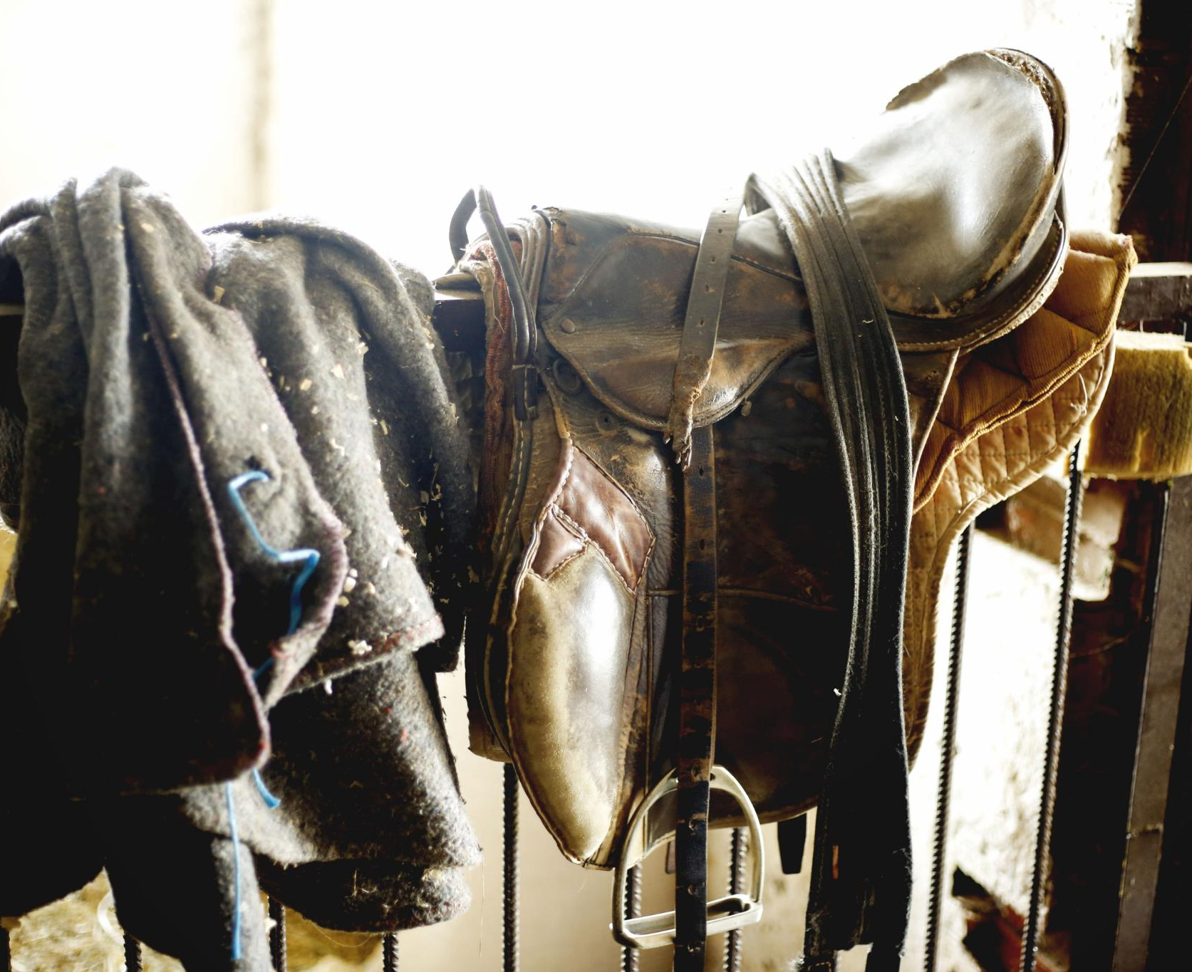
Attire Guidelines
Diverse Riding Attire
  Working Equitation includes many riding styles such as English, Western, Spanish, and Side-Saddle, embracing cultural diversity.
Safety and Appropriateness
  Attire must be safe and appropriate, with heeled boots, sleeved shirts, and matching tack for proper presentation.
Presentation and Scoring
  Presentation is judged on neatness, cleanliness, harmony, and safety, with preferred muted colors like navy and beige.
Notes:
Working Equitation embraces diverse riding traditions, and attire must reflect this diversity while maintaining safety and appropriateness. Acceptable styles include Pony Club, Riding Club, English, Western, Stock horse, Portuguese, Spanish, and Side-Saddle attire. Shirts must have sleeves, boots must be heeled and suitable for riding, and tack should match the attire. Appearance should be neat, tidy, and workmanlike, with preferred colors being muted tones like dark green, navy, and beige. Judges award a score out of 10 for presentation in the Ease of Handling phase, considering compliance, harmony, cleanliness, and safety.

Slide 15
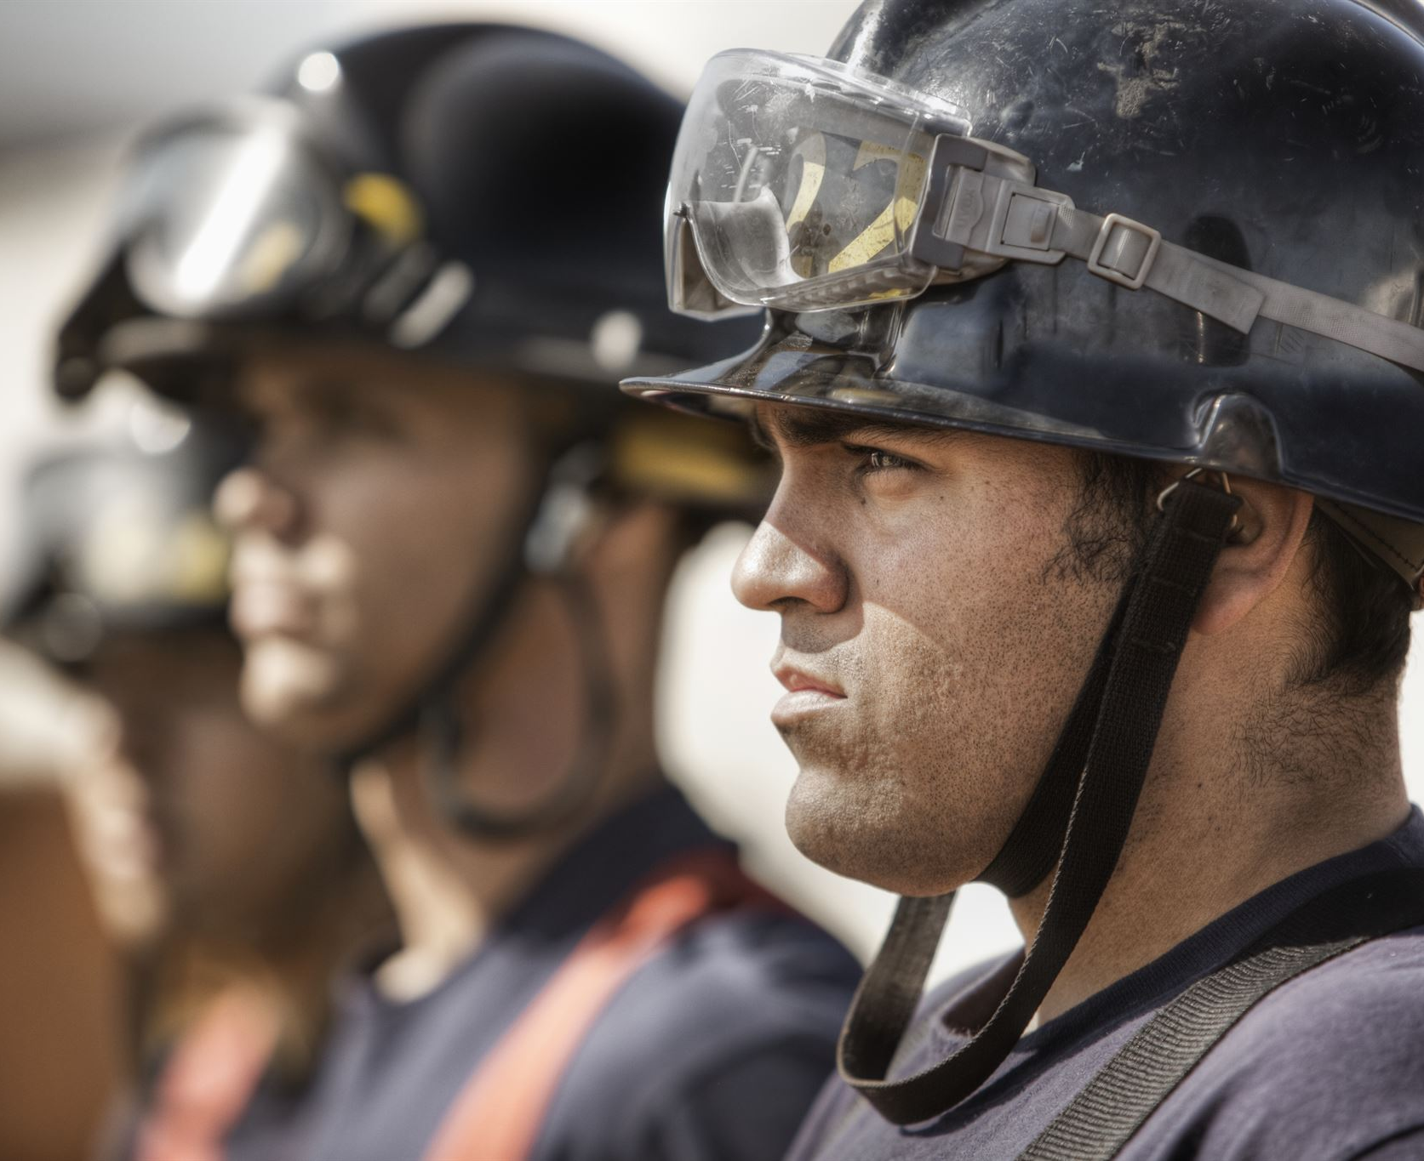
Helmet Requirements
Mandatory Helmet Use
  All riders must wear helmets to ensure safety during equestrian activities and competitions.
ESNZ Safety Standards
  Riders under 18 must use helmets that comply with ESNZ Safety Standards for enhanced protection.
Helmet Compliance Verification
  Stewards inspect helmets to ensure compliance before riders enter the competition arena.
Notes:
Helmets are compulsory for all riders. Riders under 18 must wear helmets that meet current ESNZ Safety Standards. Clubs and venues may require this standard for all riders, and such requirements must be clearly stated in the entry schedule. This rule ensures rider safety and aligns with national equestrian safety protocols. Stewards must verify helmet compliance during gear inspections and ensure that all riders adhere to these standards before entering the competition arena.

Slide 16
Health and Safety Protocols
Notes:
Blood and Lameness Protocols

Slide 17
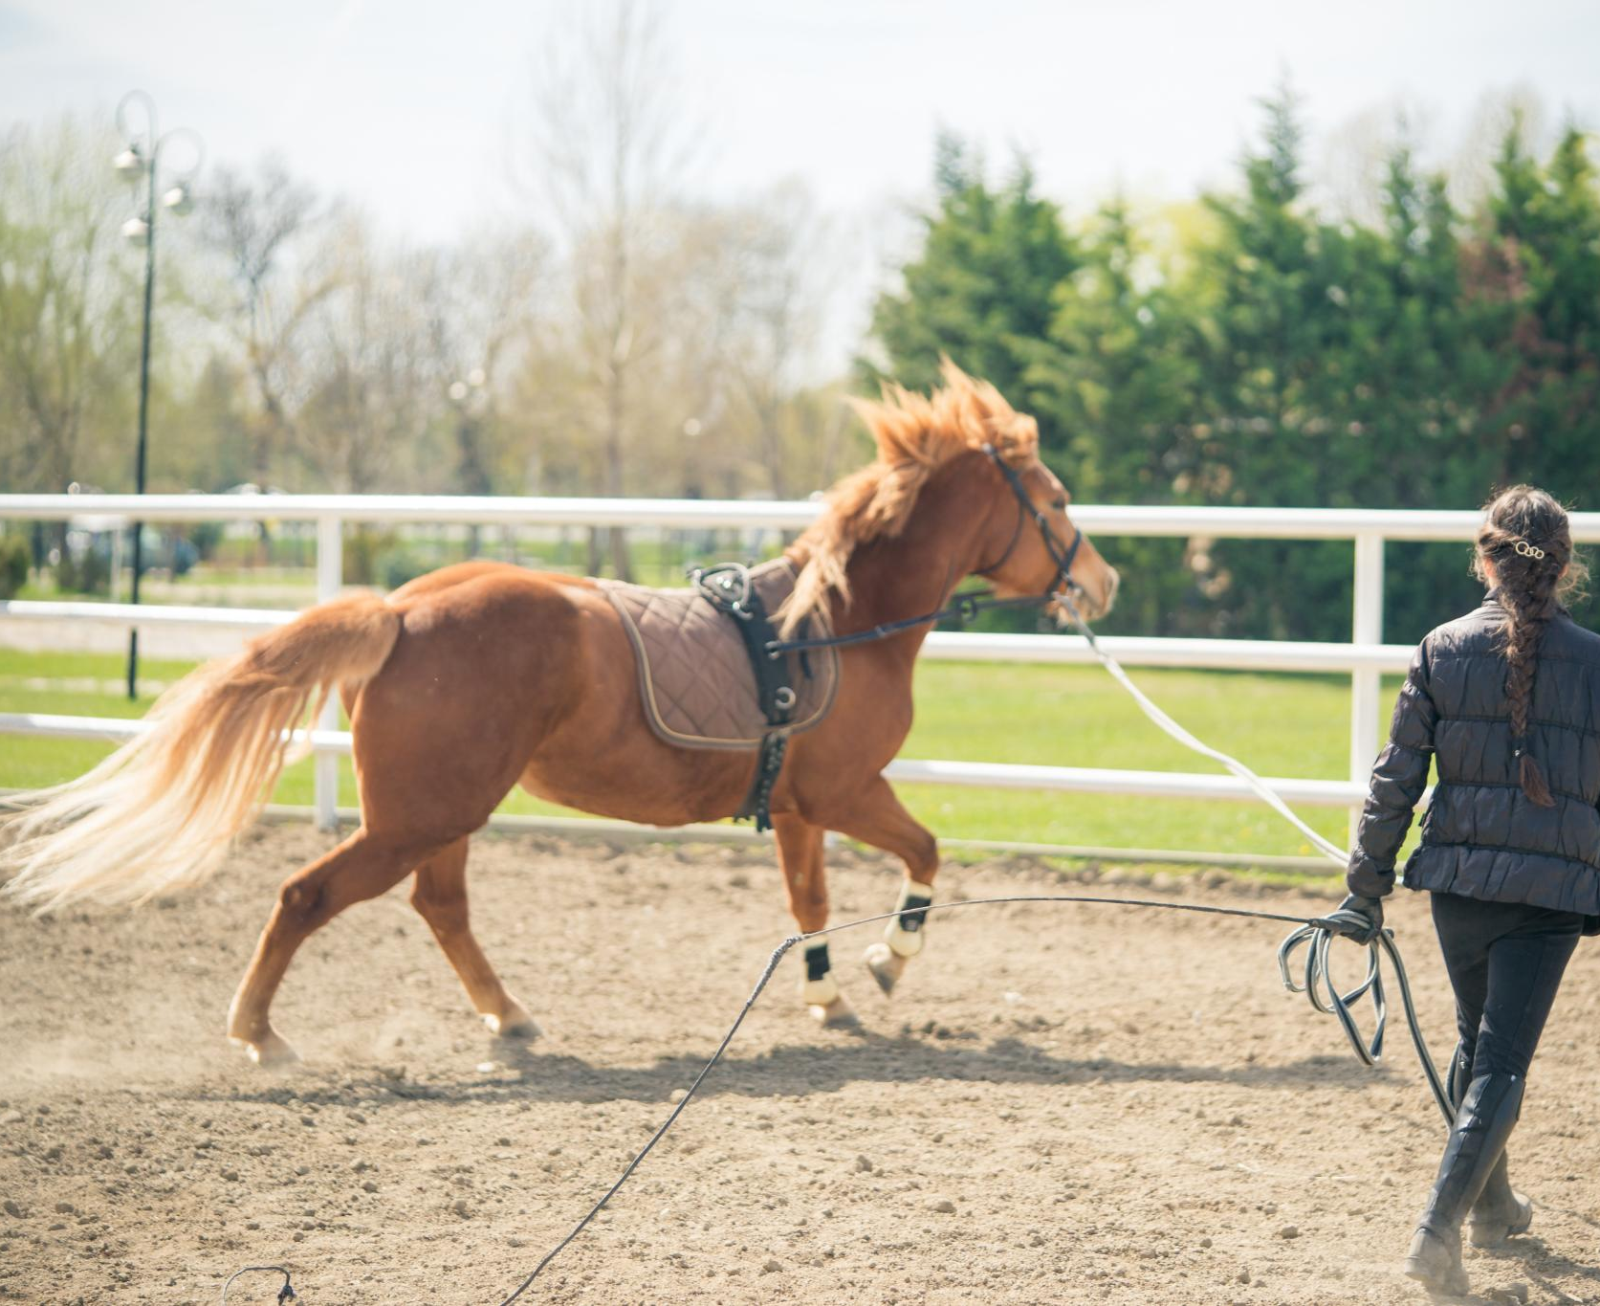
Blood and Lameness Protocols
Blood Observation and Reporting
  Stewards must report any blood on a horse to Head Judge or Show Manager for inspection and welfare assessment.
Elimination for Blood Causes
  Riders are eliminated if bleeding is caused by bit, tack, spurs, or whip to protect horse welfare.
Lameness Reporting and Elimination
  Suspected lameness must be reported and inspected; lame horses are eliminated with no appeal allowed.
Notes:
If any blood is observed on a horse, the steward must inform the Head Judge or Show Manager, who will inspect the horse. If continuing is deemed detrimental to welfare, the rider will be eliminated. During any phase, if a judge sees blood, they will ring the bell to stop the horse and inspect for injury. If the bleeding is caused by bit, tack, spurs, or whip, the rider is eliminated. If caused by other means, the judge may still eliminate the rider based on welfare concerns. Similarly, if lameness is suspected, the steward must report it, and the horse will be inspected. A lame horse will be eliminated, and there is no appeal process for eliminations due to blood or lameness.

